Slide 1

Recommendations for Flexible Auto Insurance
MIS 515
Presented by: Smrithi Ajit, Jinfeng Chen, Kavita Jain, Abhishek Gurram, Mriga Kher

Slide 2

Outline
Problem Statement
What we propose?
What is our data?
Architecture
Azure ML
Data preparation & Transformation
Analytical Questions
Data Visualizations
Observations
Conclusion
Future Scope

Slide 3
Problem Statement
Around 30% increase in Auto Insurance losses from 2014 - 2018
Lose money due to -
Mispricing insurance through underestimation of the risks
Gives rise to Unwritten losses

Slide 4
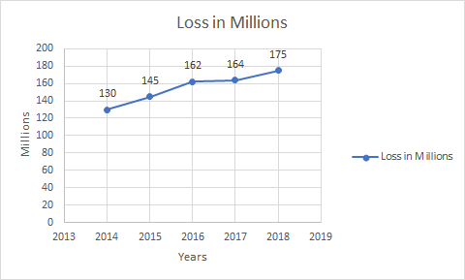
Losses Incurred

Slide 5
What is our Goal?
Identify the factors that increase risks of Unwritten losses

Slide 6
What we propose?
A flexible and customizable solution built based on the Data analytics performed to -
Identify trends and patterns in fatalities
Analyze hotspot areas for the crashes
Identify the most important temporal and spatial features that play a critical role in crashes
Give insights about if the Vehicle Make or Model Year show fatalities

Slide 7
About Dataset
Fatality Analysis Reporting System (FARS) contains data on a census of fatal traffic crashes within the 56 States.
Consists of different categorical variables that characterizes the crash, the vehicle, and the people involved
Each year records on an average 33, 000 crashes for all states in USA
Source: National Highway Traffic Safety Administration (NHTSA) https://www.nhtsa.gov/research-data/fatality-analysis-reporting-system-fars

Slide 8
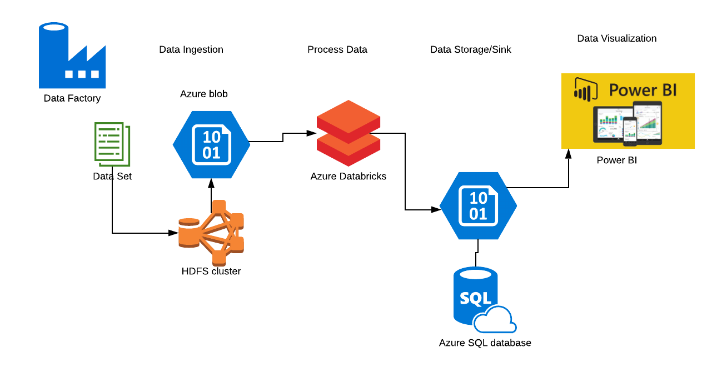
Big Data Architecture & Pipeline

Slide 9
Azure Blob Storage & Azure HDInSight
 | Blob Storage | HDInSight
Data Archiving | Can store the data without any time constraint | Reload your data into the cluster every time you provision one to perform your computations.
Data Storage Cost | Data does not have to be reloaded for every compute cluster generation, you are saving data loading costs as well. | Cost of a compute cluster is higher than the cost of the Blob Storage container
Elastic scale-cost | Blob Store's elastic scaling capabilities that you get automatically when using an Azure Storage container | Changing the scale can become a more complicated process relying on the Azure Blob

Slide 10
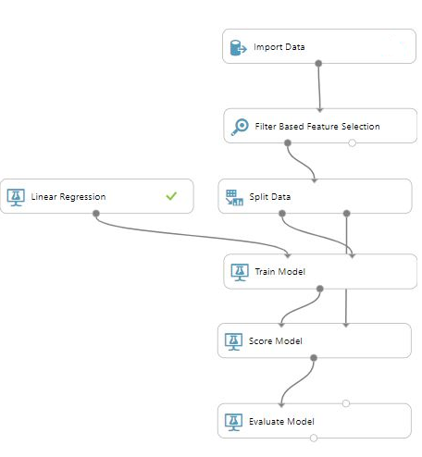
Azure Machine Learning
Azure ML Classic was used
Simple linear regression model applied to check correlation between variables
Weak correlation observed

Slide 11
Data preparation & Transformation
The raw data was cleaned for missing data
Numbers assigned to the counties had to be changed to fips code of the form sxxx where s corresponds to the state number and xxx corresponds to the county code
Aggregations done by using ‘GroupBy’ functions to get the count of Fatalities & analyse fatalities due to crashes pattern by the day of the week, month, hour and year done using Databricks spark cluster

Slide 12
Analytical Questions
Which are the hotspots by state/county?
What are the factors that give useful insights into the crash analysis?
What are the general trends with respect to the category of the accident recorded, frequency of accidents over the day/week/year and so on?
What are the temporal & Spatial distribution patterns in the data?

Slide 13
Significant Variables
Relevant Variables | Description
FATALS | number of fatally injured persons in the crash.
COUNTY | location of the event in regard to the county
GENDER | gender
AGE | age
MONTH | the month when the crash occurred
DAY_WEEK | day of the week when the crash occurred
HOUR | the hour when the crash occurred
State | state name
RUR_URB | land area where the crash occurred
MAKE | vehicle make
MOD_YEAR | vehicle model year
TWAY_ID | Toll Way

Slide 14
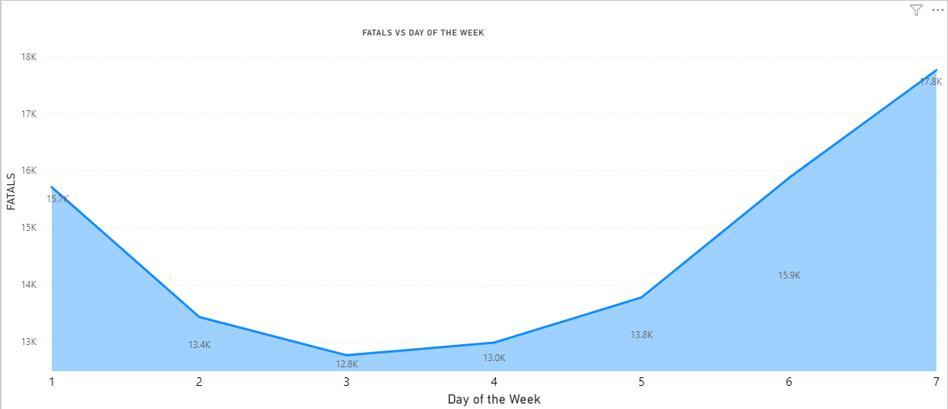
Temporal Analysis

Slide 15
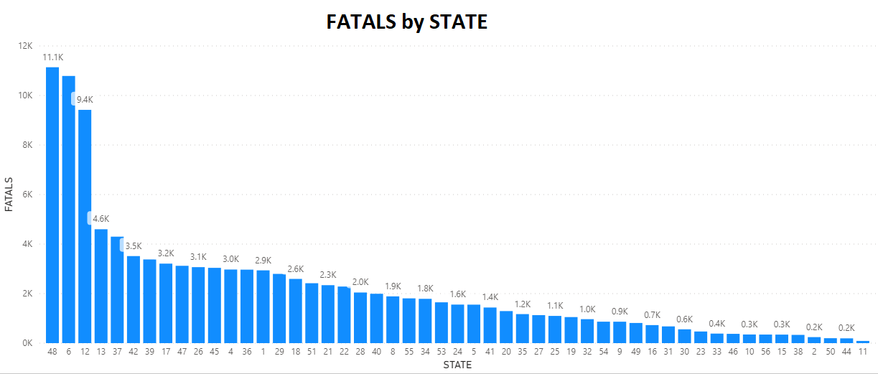
Spatial Analysis
Top 5 most affected States:
48 - Texas
6 - California
12 - Florida
13 - Georgia
37 - North Carolina

Slide 16
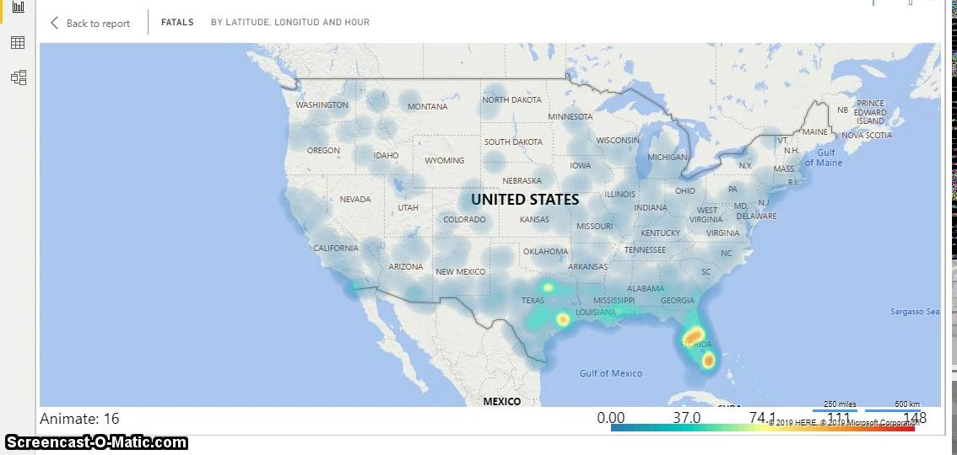
Hot Spots

Slide 17
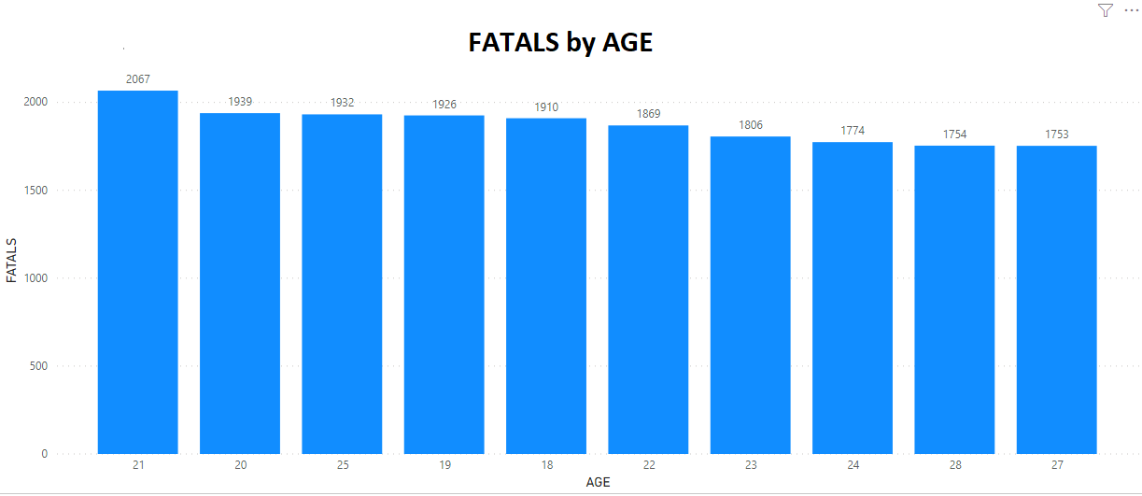
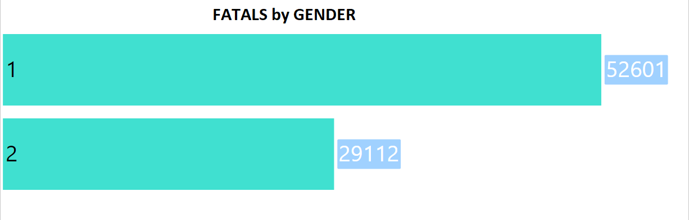
Demographics
Age Group of 18-28 is the most affected.

Slide 18
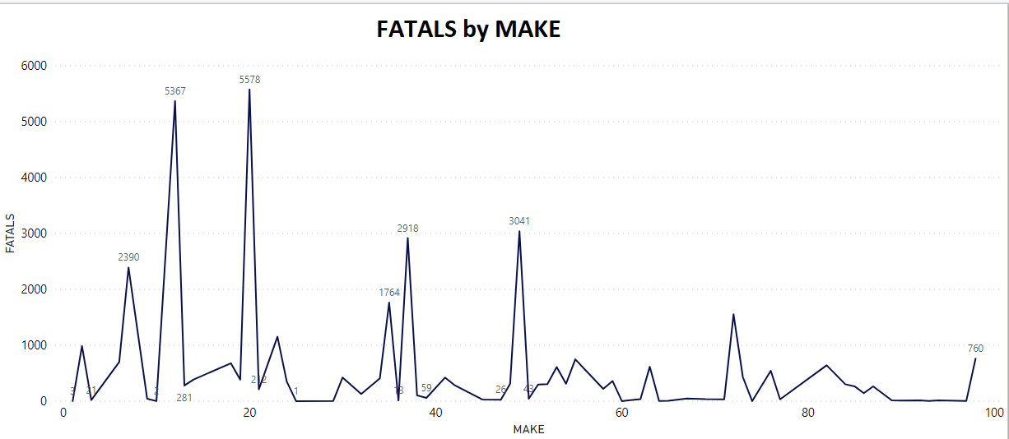
Chevrolet
Ford
Toyota
Honda

Slide 19
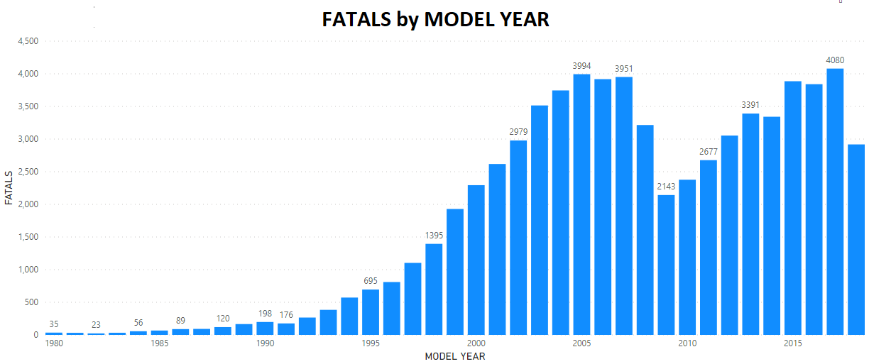

Slide 20
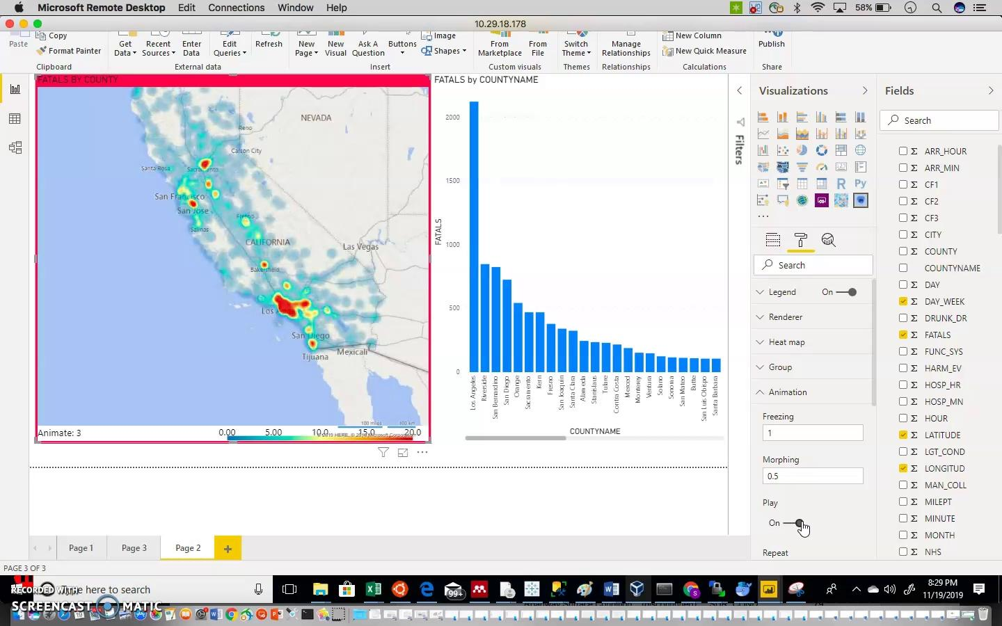
Data Visualization (Cont.)

Slide 21
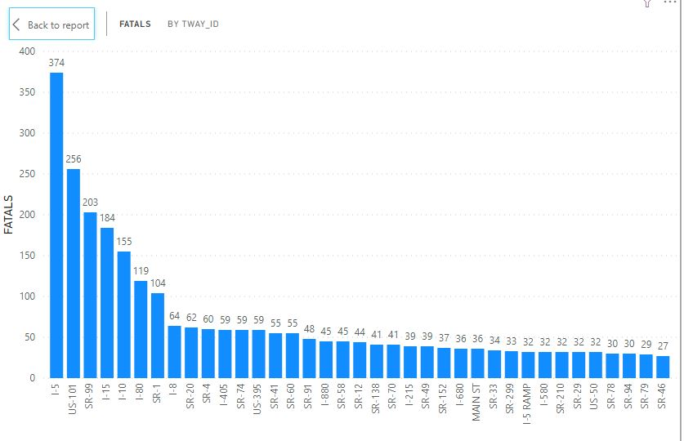
Fatality by major routes in California
I-5
US-101
SR-99
I-5
I-10
I-8

Slide 22
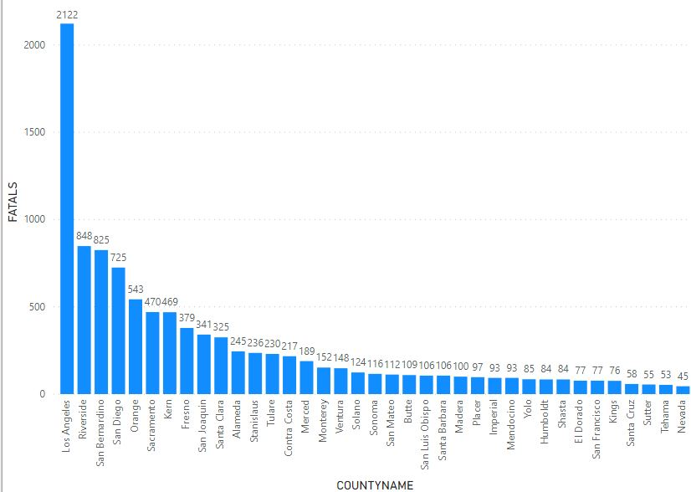
Fatality based on the County
Los Angeles
Riverside
San Bernardino
San Diego
Orange
Sacramento

Slide 23
Observations
For the total number of fatalities that have occurred in the 3-year window 2016-2018 we see that LA has as many as over 2000 fatalities with nearly 62% of them being on the Urban routes and 37.03% on rural routes
Hotspot areas in terms of counties are Los Angeles, Riverside, San Bernardino, San Diego, Orange, Sacramento, Kern, Fresno, San baquin in the decreasing order

Slide 24
Conclusion
Certain days of week are more susceptible to crashes.
Significant routes, Interstate roads and State highways I-5, US-101, SR-99, I-10, I-8.
Age group of 18 to 27 was found particularly susceptible to accidents
Males tend to be involved in a higher percentage of crashes than women.
As for the vehicle make, 2 models that were involved in more number of crashes were Ford & Chevrolet .

Slide 25
Future Scope
Use of Clustering algorithms( Unsupervised methods) and create either spatial or demographic clusters or both
Use research along with insights drawn to categorize customers as low, medium or high-risk

Slide 26
References
Fatal Motor Vehicle Accidents. (2019, September 5). Retrieved from
https://data-usdot.opendata.arcgis.com/datasets/fatal-motor-vehicle-accidents?geometry=-232.151,-4.687,127.849,75.554
Facts Statistics: Auto insurance. (2019). Retrieved from https://www.iii.org/fact-statistic/facts-statistics-auto-insurance
Crash Data Location. (2019, May 14). Retrieved from https://data.iowadot.gov/datasets/cbd84abf01894f4a8404d6990ad2eb2e_0?geometry=-110.091,38.962,-43.338,44.686
USAGE-BASED INSURANCE AND TELEMATICS. (2019, May 17). Retrieved from https://www.naic.org/cipr_topics/topic_usage_based_insurance.htm

Slide 27

Thank you!

